Slide 1
Điều trị toàn thân ung thư tuyến tiền liệt
Nguyễn Hoàng Quý

Slide 2

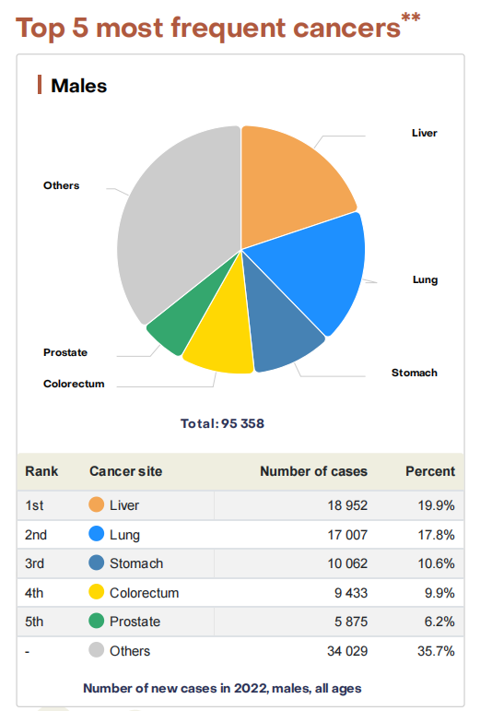
Nhìn từ Globocan 2022

Slide 3

Chẩn đoán K TLT
mCRPC
Giai đoạn cuối đời (BSC)

Slide 4
Chẩn đoán K TLT
Giai đoạn sớm: tại chỗ
Tiến xa tại chỗ
nmHSPC
nmCRPC
Giai đoạn trễ: di căn
de novo
mHSPC
Giai đoạn trễ:
tái phát di căn
mHSPC
mCRPC
Giai đoạn cuối đời (BSC)

Slide 5
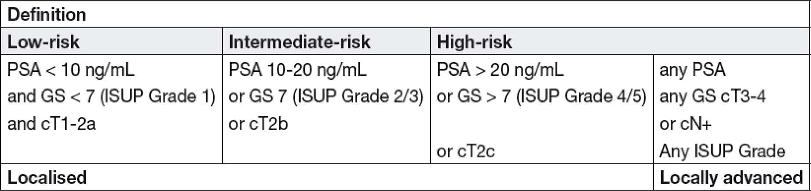
Ung thư tuyến tiền liệt: chẩn đoán
Giai đoạn sớm - tại chỗ
Giai đoạn tiến xa
Nguy cơ thấp
Tại chỗ
Ung thư TTL
Nguy cơ trung bình
Di căn (tạng, xương)
Nguy cơ cao
HSPC vs CRPC ?
3

Slide 6
Ung thư tuyến tiền liệt tiến xa (APC)
Giai đoạn nhạy nội tiết (HSPC)
Giai đoạn kháng cắt tinh hoàn (CRPC)
nmHSPC
nmCRPC
Ung thư TTL tiến xa
mHSPC
mCRPC
3
https://www.urotoday.com/conference-highlights/esmo-2022/esmo-2022-prostate-cancer/139441-esmo-2022-invited-discussant-metastatic-castration-sensitive-prostate-cancer-2022-updates.html

Slide 7
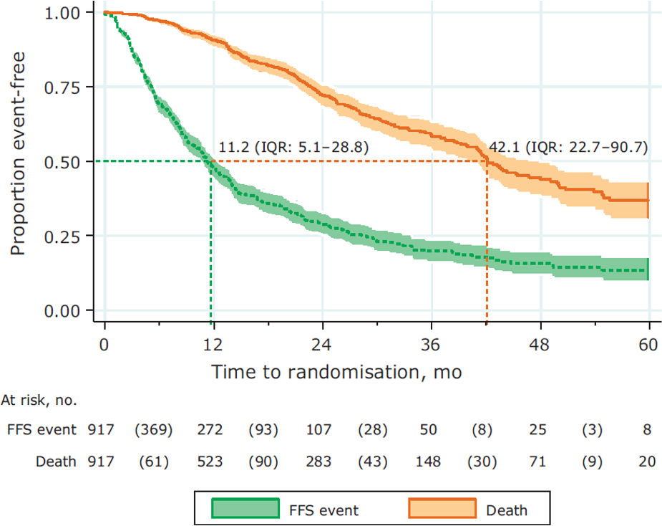
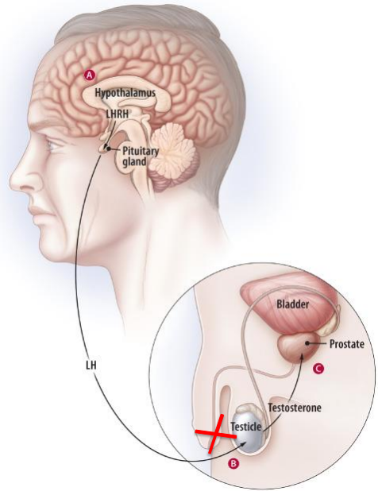
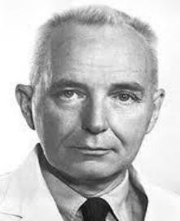
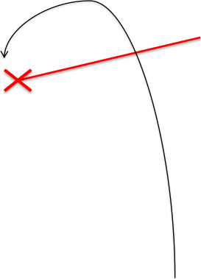

Điều trị ung thư tuyến tiền liệt tiến xa: vai trò ADT
GnRH Analogues • LHRH agonists (Goserelin, Leuprolin, Pamorelin …) • Require testosterone flare protection at treatment initiation (e.g. 4 weeks of bicalutamide 50mg) • LHRH antagonists (Degarelix, Relugolix)
Charles Huggins
Giải Nobel năm 1966
Vai trò của ADT đơn trị trong các thử nghiệm lâm sàng?
Orchiectomy

Slide 8
Vai trò ADT trong mHSPC
 | STAMPEDE control arm 917 synchronous mHSPC | LATITUDE control arm 602 synchronous, high- risk mHSPC | TITAN control arm 527 mHSPC (syn- und metachronous)
Median age | 66 | 67 | 68
Median PSA | 112 | NA | 4
Bone M1 | 88% | 98% | 100%
Liver M1 | 4% | 5% | 2.5%
Time to CRPC | 11.2 months | 7.4 months | 11.4 months
Median OS | 42.1 months | 36.5 months | 52 months
James Eur Urol 2014
Fizazi Lancet Onc 2019 Chi NEJM 2019
Chi GUASCO 2021
Content of this presentation is copyright and responsibility of the author. Permission is required for re-use.

Slide 9


Vai trò ADT trong mHSPC khi điều trị kết hợp ?
R A N D O M I S E D
A) ADT đơn trị
Superiority proven
B > A
C > A
D > C
E > A
Weak evidence for C = B in terms of improvement in OS
F over B and E only rPFS, low- volume
No data or pending
D over B
G over F
B) ADT + ARPI
mHSPC
C) ADT + Docetaxel
D) ADT + Docetaxel + ARPI
E) ADT + RT primary tumour
F) ADT + RT primary tumour + ARP
Tiêu chí lựa chọn trong các thử nghiệm lâm sàng ?
high-risk / high-volume / high metastatic burden?
G) ADT + Docetaxel + Abiraterone + RT primary tumour
ARPI: Abirateron/Prednison, Apalutamid, Darolutamid, Enzalutamid

Slide 10
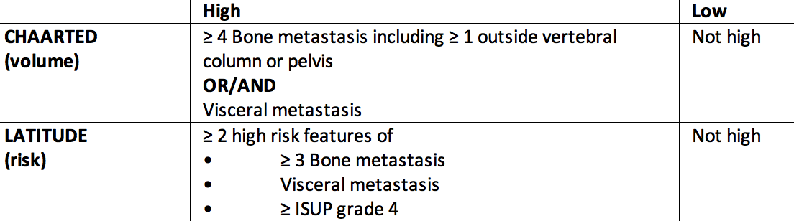
High-volume vs high-risk
Low-volume vs low-risk
STAMPEDE
(metastatic burden)
Parker C et al. Lancet 2018

Slide 11
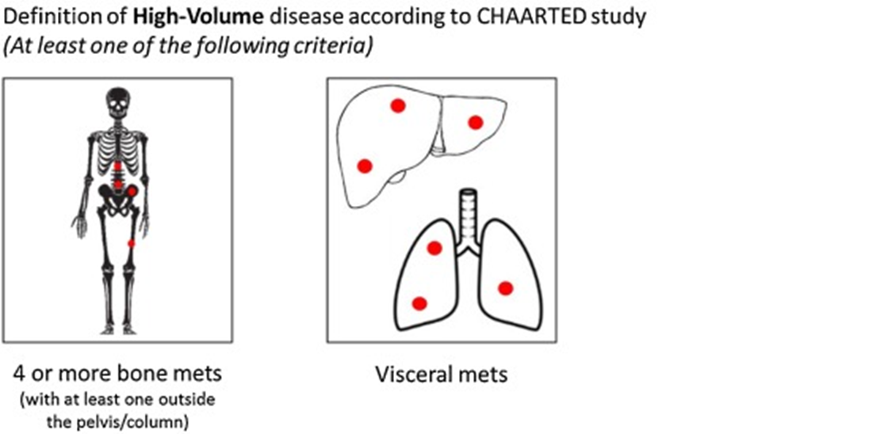


Slide 12
Các tiêu chí chọn lựa trong nghiên cứu mHSPC ?
Term | Definition | Reference
High metastatic burden | = High-volume | STAMPEDE Trial Parker Lancet 2018
Synchronous (= de-novo) M1 | M1 without prior treatment of the primary tumour
Metachronous (relapsed) M1 | M1 relapsing after local treatment of the primary (OP or RT ± Salvage RT)
Imaging | • Conventional imaging: Bonescintigraphy, CT and/or MRI • Next-generation imaging: Whole-body, diffusion weighted MRI, PET/CTor PET/MRI (different tracers) | APCCC EJC 2023
ARPI | • Abirateron/Prednison, Apalutamid, Darolutamid, Enzalutamid
ARPI: androgen receptor pathway inhibitors

Slide 13

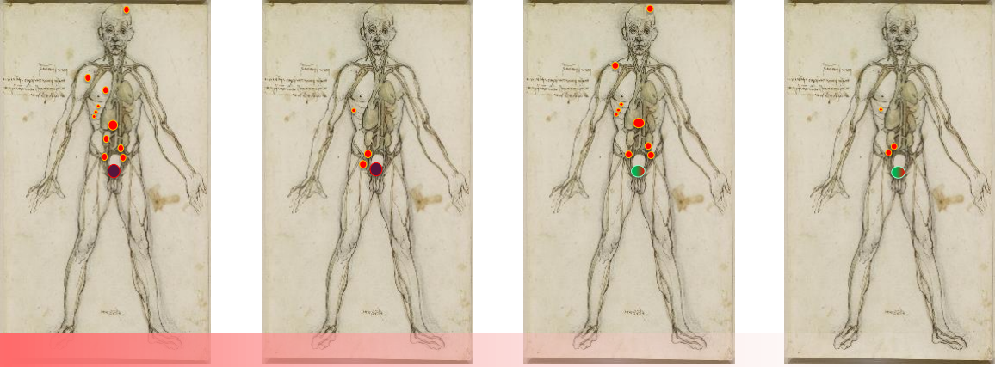
Các “kịch bản lâm sàng” của mHSPC ?
Synchronous mHSPC |  | Metachronous mHSPC
High-volume/risk | Low-volume/risk | High-volume/-risk | Low-volume/-risk
Median OS few years Median OS several years Median OS many years
Aurelius Omlin
Content of this presentation is copyright and responsibility of the author. Permission is required for re-use.

Slide 14
Vai trò ADT trong mHSPC khi điều trị kết hợp ?
Tiêu chí
• Cải thiện OS
• Cải thiện rPFS
• Cải thiện thời gian đến CRPC
• Cải thiện QoL
R A N D O M I S E D
A) ADT đơn trị
B) ADT + ARPI
mHSPC
C) ADT + Docetaxel
D) ADT + Docetaxel + ARPI
E) ADT + RT primary tumour
F) ADT + RT primary tumour + ARP
ADT + Hóatrị?
G) ADT + Docetaxel + Abiraterone + RT primary tumour
ARPI: Abirateron/Prednison, Apalutamid, Darolutamid, Enzalutamid

Slide 15
Vai trò ADT trong mHSPC khi điều trị kết hợp ?
R A N D O M I S E D
ADT đơn trị
mHSPC
ADT + Docetaxel
Cơ sở khoa học Docetaxel ?

Slide 16
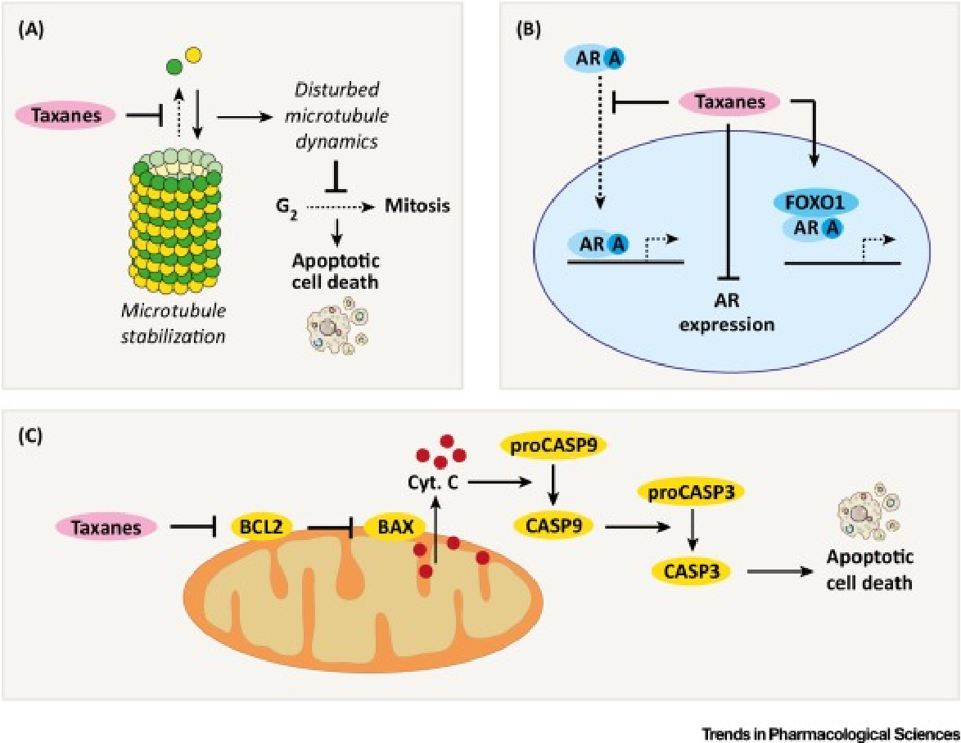
ADT + Docetaxel
Nhạy nội tiết (HSPC)
https://acsjournals.onlinelibrary.wiley.com/doi/10.3322/canjclin.55.5.300

Slide 17


ADT + Docetaxel vs ADT đơn trị
Nhạy nội tiết (HSPC)
ADT
Castration- sensitive/naïve men (M1)
ADT +
Docetaxel 75mg/m2 Every 21d x 6 CK
GETUG-15 CHAARTED STAMPEDE
n=385 n=790 n= 2962
2004-2008
2006-2012
2005-2013
Gravis G Lancet Oncol. 2015; Sweeney CJ N Engl J Med. 2015;James ND Lancet. 2016

Slide 18

CHAARTED: OS
Nhạy nội tiết (HSPC)
Median follow-up of 53.7 mos in patients with metastatic hormone-sensitive prostate cancer randomized to ADT + docetaxel vs ADT alone (N = 790)
Total Patient Population
High-Volume Disease
Low-Volume Disease
mOS, Mos
ADT + docetaxel 57.6
ADT alone 47.2
HR: 0.72 (95% CI: 0.59-0.89; P = .0018)
mOS, Mos
ADT + docetaxel 51.2
ADT alone 34.4
HR: 0.63 (95% CI: 0.50-0.79; P < .001)
mOS, Mos
ADT + docetaxel 63.5
ADT alone NR
HR: 1.04 (95% CI: 0.70-1.55; P = .86)
100
100
100
80
80
80
60
60
60
Survival (%)
40
40
40
20
20
20
0
0
0
0
12
24
36
48
60
72
84
96
108
0
12
24
36
48
60
72
84
96
0
108
12
24
36
48
60
72
84
96
108
Mos
Mos
Mos
Kyriakopoulos. JCO. 2018;36:1080.
Slide credit: clinicaloptions.com
Notes:
ADT, androgen-deprivation therapy; mOS, median OS; NR, not reached.

Slide 19

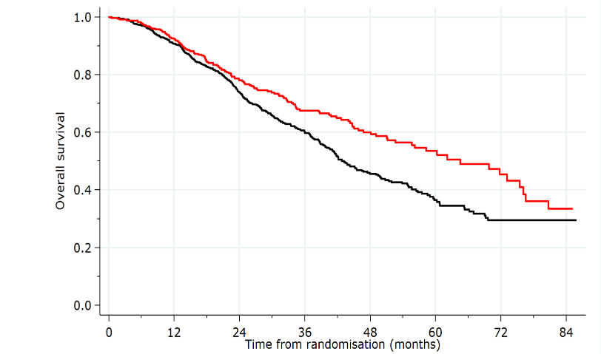
STAMPEDE: OS
SoC: 343 deaths
SoC + Doc: 134 deaths
HR: 0.73 (95% CI: 0.59-0.89;P = .002)
SoC + Doc
SoC
Median OS, Mos (95% CI)
SoC 43 (24-88)
SoC + Doc 65 (27-NR)
James. Lancet. 2016;387:1163.
Notes:
Doc, docetaxel; NR, not reached; SoC, standard of care.

Slide 20
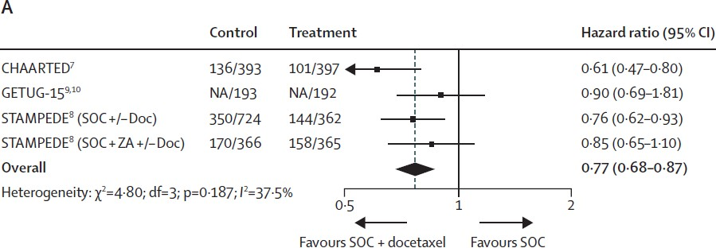

ADT + Docetaxel: OS - Phân tích tổng hợp
M1 Patients
Hóa trị giới hạn số chu kỳ, có thể lựa chọn thay thế hóa trị ?
Vale C et al. Lancet Oncol 2016

Slide 21
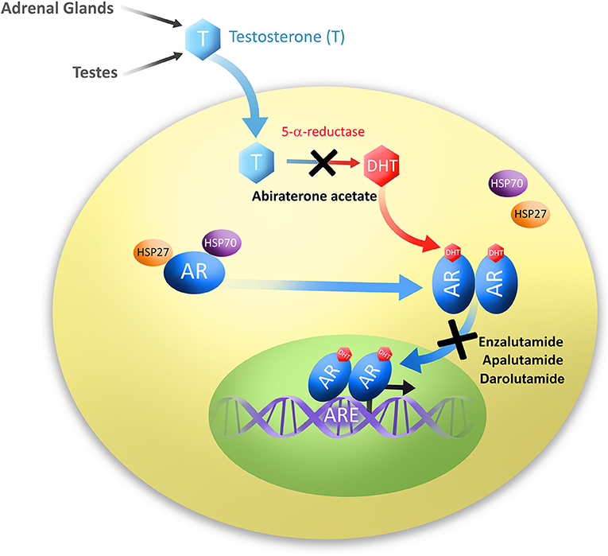
ADT + LPNT: từ sinh học phân tử đến thử nghiệm lâm sàng
ARPI: Abirateron/Prednison, Apalutamid, Darolutamid, Enzalutamid
https://www.frontiersin.org/articles/10.3389/fonc.2019.00801/full

Slide 22
Vai trò ADT trong mHSPC khi điều trị kết hợp ?
R A N D O M I S E D
ADT + ARPI ARPI: Abirateron/Prednison, Apalutamid, Darolutamid, Enzalutamid
mHSPC
ADT +/- Docetaxel

Slide 23
Liệu pháp nội tiết
 | ARCHES ADT + Enza vs ADT + Placebo | TITAN ADT + Apa vs ADT + Pbo | LATITUDE ADT + Abi/P vs ADT + Pbo | STAMPEDE ADT + Abi/P vs SOC (M1)
n | 1150 | 1052 | 1199 | 1003
High-Volume | 63% | 63% | All high-risk | 47% high risk
De Novo M1 | 67% | 81% | 100% | 94%
Docetaxel | 18% | 11% before | 0% | 0%

Slide 24
LATITUDE: Abiraterone vs Placebo
100
80
Median Treatment Exposure
ADT + AA + P: 25.8 mos
ADT + placebos: 14.4 mos
ADT + Abiraterone + P: 53.3 th
60
OS (%)
40
No. of Events
ADT + AA + P: 275 (46%)
ADT + placebos: 343 (57%)
ADT + placebos: 36.5 mos
20
HR: 0.66 (95% CI: 0.56-0.78; P < .0001)
0
0
6
12
18
24
30
36
42
48
54
60
66
Patients at Risk, n
Mos
ADT + AA + P
597
565
529
479
425
389
351
311
240
124
40
0
ADT + placebos
602
564
505
432
368
315
256
220
165
69
23
0
mOS nhóm ADT + AA + P đạt 4.5 năm
16.8 tháng kéo dài hơn so với ADT + placebos
Fizazi. Lancet Onc. 2019;[Epub].
Notes:
AA, abiraterone acetate; ADT, androgen deprivation therapy; P, prednisone.

Slide 25
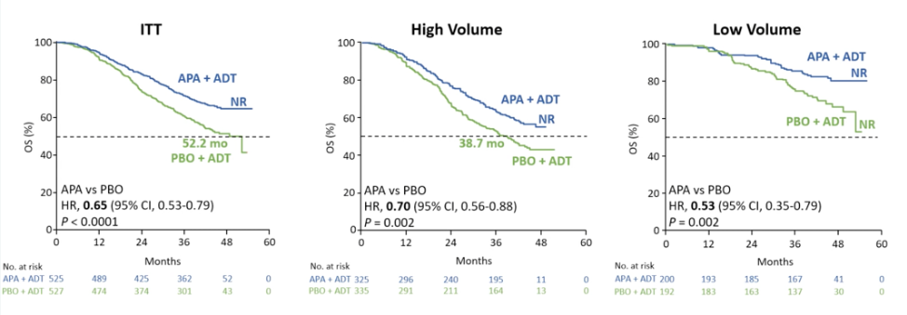
TITAN: Apalutamide vs Placebo

Slide 26
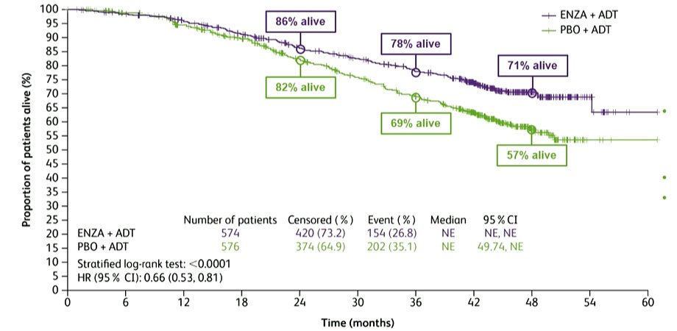
ARCHES: Enzalutamide vs Placebo
Notes:
ADT, androgen deprivation therapy; Enza, enzalutamide; NR, not reached; Pbo, placebo.

Slide 27


Enzalutamide vs Abiraterone vs Apalutamide ?
R A N D O M I S E D
ADT + Abiraterone
Hormone-sensitive prostate
cancer
ADT + Enzalutamide
ADT + Apalutamide
Primary Endpoint
OS
Chưa có nghiên cứu đối đầu ?

Slide 28
mHSPC: lựa chọn điều trị 2024 ?
 | Synchronous M1 High-burden* | Synchronous M1 Low-burden* | Metachronous M1 High-burden* | Metachronous M1 Low-burden*
ADT alone | No | Genereally no | No | Selected cases
ADT + Docetaxel | Generally no | No | No | No
ADT + Abirateron/P | One of the options | No approval | No approval | No approval
ADT + Enzalutamid |  | Yes | Yes | Yes
ADT + Apalutamid
ADT + Docetaxel + Abirateron/Por Darolutamide | For patients fit for docetaxel | Triplet therapy for selected cases | Triplet therapy for very selected cases | No
Treatment of the primary tumour | Selected patients with the aim to prevent local complications | Yes (RT) | Only in case of local complications
Metastases directed therapy | Only in case of local complications | Selected cases, ideally on clinical trial | Only in case of local complications | Selected cases, ideally on clinical trial
* Volume and/or risk (CHAARTED and LATITUDE definitions APCCC 2022 Eur J Cancer. 2023 Mar 3;185:178-215

Slide 29




Toàn cảnh điều trị ung thư tuyến tiền liệt tiến xa
Locally Advanced Prostate Cancer LAPC
Hormone-sensitive Prostate Cancer HSPC
Castration-resistant Prostate cancer CRPC
nmHSPC
nmCRPC
Adjuvant or salvage RT
ADT + • Enzalutamide • Apalutamide • Darolutamide
ADT + Enzalutamide Enzalutamide alone
Locally advanced or N1
PSA Rise Metachronous
RP + ePLND ± aRT RT + ADT + Abiraterone
± ADT
mHSPC
mCRPC
ADT +/- • Abiraterone/P • Apalutamide • Docetaxel • Enzalutamide • Doce + Abi/P • Doce + Daro RT low burden M1
Abiraterone/P, Cabazitaxel, Docetaxel, Enzalutamide, Radium-223, ¹⁷⁷ Lu-PSMA Inpatients with HRD alterations: Olaparib, Rucaparib Combination of ARPI plus PARPi Inpatients with dMMR/MSI-high or TMB high: Checkpoint inhibition
Synchronous
RP: Radical prostatectomy
ePLND: extended pelvic lymph node dissection
RT: Radiotherapy
ADT: Androgendeprivation therapy
M1: Metastatic disease
Aurelius Omlin
Content of this presentation is copyright and responsibility of the author. Permission is required for re-use.

Slide 30
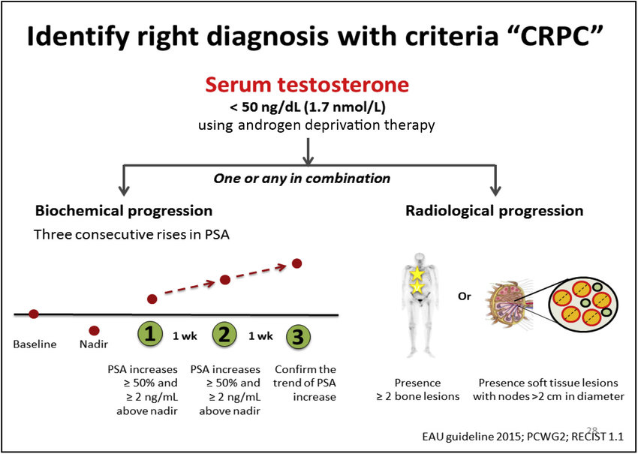
Định nghĩa kháng cắt tinh hoàn
CRPC
Notes:
EAU 2015

Slide 31
Ung thư tuyến tiền liệt tiến xa (APC)
Giai đoạn nhạy nội tiết (HSPC)
Giai đoạn kháng cắt tinh hoàn (CRPC)
M0-CRPC
Ung thư TTL tiến xa
M1-CRPC
https://www.urotoday.com/conference-highlights/esmo-2022/esmo-2022-prostate-cancer/139441-esmo-2022-invited-discussant-metastatic-castration-sensitive-prostate-cancer-2022-updates.html
3

Slide 32
Chẩn đoán K TLT
Giai đoạn sớm: tại chỗ
Tiến xa tại chỗ
nmHSPC
nmCRPC
Giai đoạn trễ: di căn
de novo
mHSPC
Giai đoạn trễ:
tái phát di căn
mHSPC
Abiraterone
Cabazitaxel
Docetaxel
Enzalutamide
Radium-223
(Sipuleucel-T: in US only)
Olaparib, Rucaparib (if DDR
alterations)
Lutetium -PSMA
Pembrolizumab
mCRPC
Giai đoạn cuối đời (BSC)

Slide 33

Chẩn đoán K TLT
Giai đoạn sớm: tại chỗ
Tiến xa tại chỗ
nmHSPC
nmCRPC
Giai đoạn trễ: di căn
de novo
mHSPC
Giai đoạn trễ:
tái phát di căn
mHSPC
Docetaxel
Abiraterone
Enzalutamide
Olaparib
Pembrolizumab
mCRPC
Giai đoạn cuối đời (BSC)

Slide 34




Ung thư tuyến tiền liệt tiến xa (APC)
Treatment Options 2024
Androgen-Deprivation
+ Abirateron
+ Enzalutamid (mHSPC)
Enzalutamid without ADT high-risk nmHSPC
+ Apalutamid
+ Docetaxel
+ Radiation therapy primary tumour
+ Docetaxel plus Abirateron
+ Docetaxel plus Darolutamid
Treatment Options 2024
Androgen-Deprivation
+ Abirateron
+ Enzalutamid (nmCRPC and mCRPC)
+ Apalutamid only nmCRPC
+ Darolutamid only nmCRPC
+ Docetaxel
+ Cabazitaxel
+ Radium-223
+ Lutetium-177
+ Olaparib
+ Rucaparib
+ Olaparibor Niraparib plus Abirateron
+ Enzalutamid plus Talazoparib
+ Pembrolizumab in case MSI-high a/o TMB-high
800
PSA Wert
288
242
45
2.7
0.6
0.1
0.01
0.01
0.01
0.05
0.15
0.9
₃ ¹⁵
HSPC CRPC
Aurelius Omlin Content of this presentation is copyright and responsibility of the author. Permission is required for re-use.

Slide 35
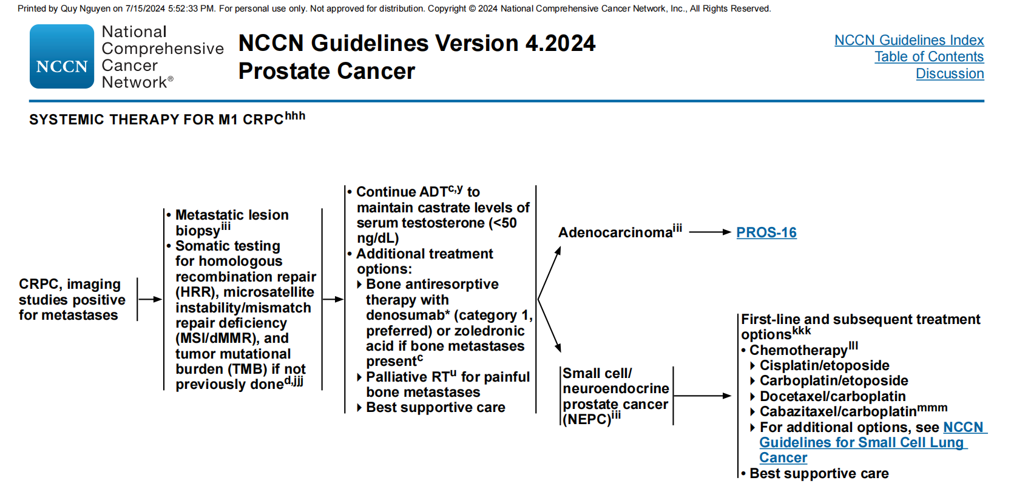

Slide 36
Ung thư tuyến tiền liệt tiến xa: các tình huống lâm sàng
mCRPC
Giai đoạn kháng cắt tinh hoàn (mCRPC)
de novo met
tái phát di căn CRPC
Ung thư TLT di căn
Điều trị trước đó
Chưa điều trị
Docetaxel và Nội tiết
Docetaxel
Nội tiết
Docetaxel
Nội tiết
Docetaxel
Nội tiết
3

Slide 37

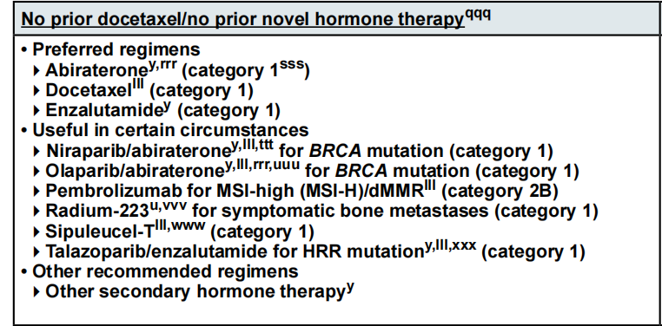
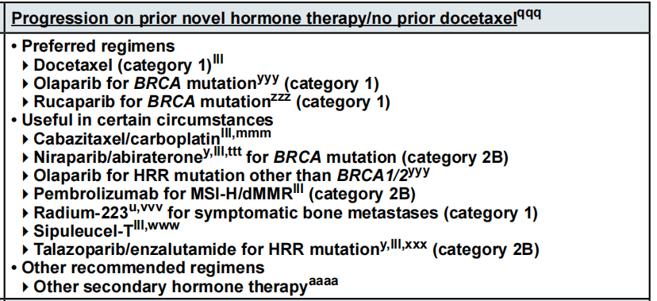

Slide 38
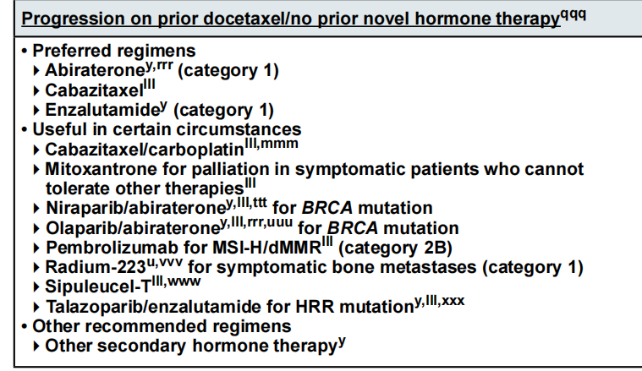
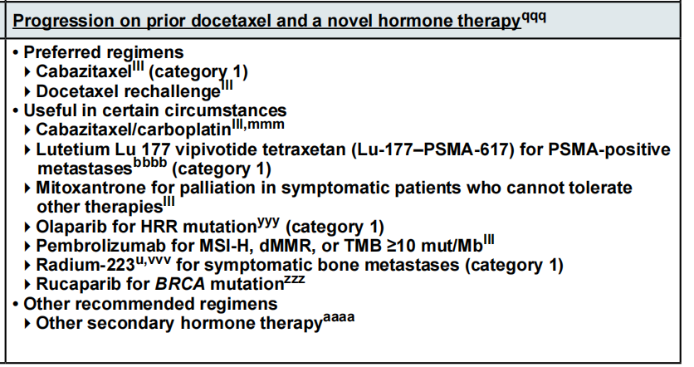

Slide 39
mCRPC: sau điều trị ADT ± DOCETAXEL
mHSPC: ADT ± Docetaxel | Treatment | Primary Endpoints | Approval CH | Reference
 | Abirateron vs. Placebo/P | • OS: 34.7mvs 30.3m • rPFS: 16.5 vs 8.2 | mCRPC first-line, no visceral metastases | COU-302 Ryan NEJM 2013
 | Enzalutamid vs. Placebo | • OS: 35.5 vs 31.3m • rPFS: 20 vs 5.4m | mCRPC first-line | PREVAIL Beer NEJM 2014
 | Abirateron plus Niraparib vs. Abirateron/P | • OS: not significant • rPFS BRCA1/2: 19.9 vs 10.9m | No approval CH FDA/EMA: only BRCA1/2 | MAGNITUDE Chi JCO 2023
 | Abirateron plus Olaparib vs. Abirateron/P | • OS: Not significant • rPFS BRCA1/2: NR vs 8.4m • rPFS HRRm: NR vs 13.9m • rPFS non HRRm: 24.1 vs 19m | No approval CH FDA: only BRCA1/2 EMA: all mCRPC | PROpel Clarke NEJM Evidence 2022
 | Enzalutamid plus Talazoparib vs. Enzalutamid | • OS: Pending • rPFS BRCA1/2: HR 0.23 • rPFS HRRm: 27.9 vs 16.4m • rPFS non HRRm: NR vs 22.5 | No approval CH FDA: only BRCA1/2 EMA: all mCRPC | TALAPRO2 Agarwal Lancet 2023
 | Docetaxel vs. Mitoxantron | • OS: 18.9 vs 16.5m • rPFS: not available | mCRPC first-line (Docetaxel re-challenge*) | TAX327 Tannock NEJM 2004
 | Cabazitaxel vs. Mitoxantron | • OS: 15.1 vs 12.7m • rPFS: not availble | mCRPC after Docetaxel (PDonor after <6 months of Docetaxel) | TROPIC De Bono Lancet 2010
Aurelius Omlin
* Docetaxel Re-Challenge: limited antitumour activity
Content of this presentation is copyright and responsibility of the author. Permission is required for re-use.

Slide 40
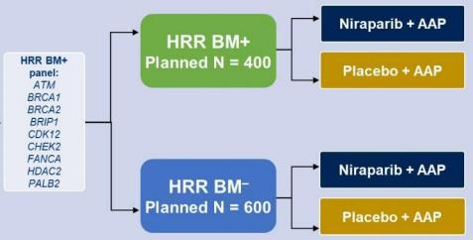
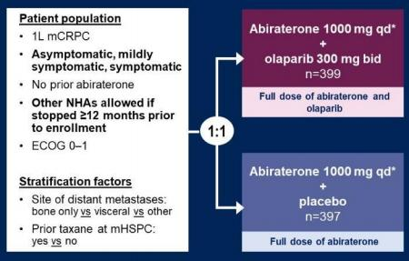
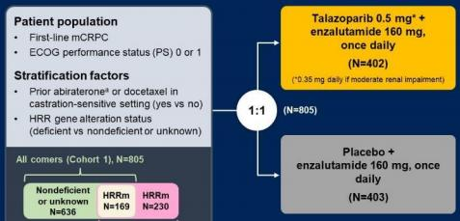
mCRPC: PARPi + AAP
Propel
Magnitude
Talapro-2
Content of this presentation is copyright and responsibility of the author. Permission is required for re-use.

Slide 41
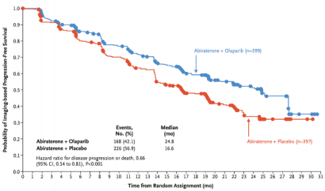
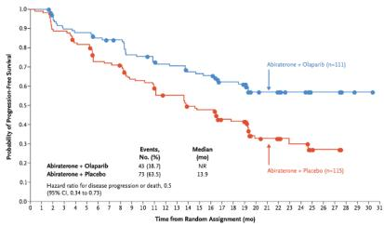
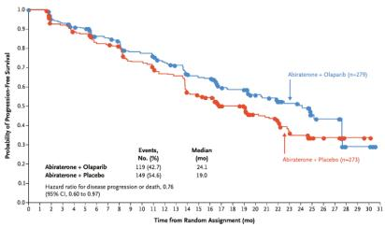
mCRPC: PROPEL TRIAL
ITT Population HRR Mutated Non-HRR Mutated
Clarke N,et al. N EnglJ Med Evidence 2022 Saad F, et al. Lancet 2023
Content of this presentation is copyright and responsibility of the author. Permission is required for re-use.

Slide 42
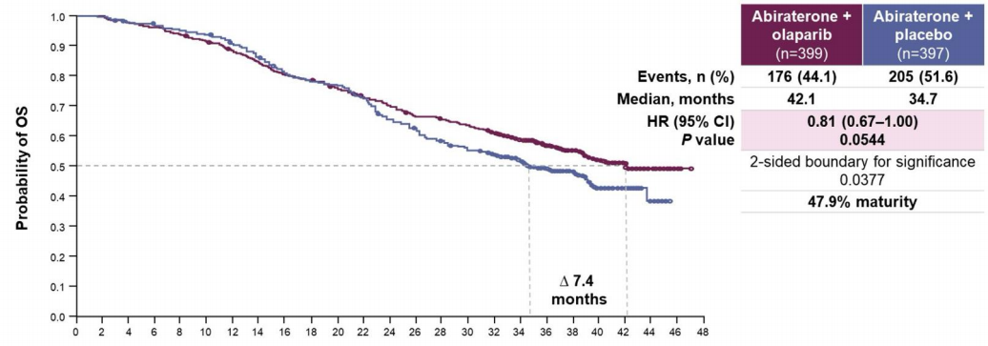
mCRPC: PROPEL TRIAL
Final Overall Survival Pre-specified Analysis
Clarke N,et al. N EnglJ Med Evidence 2022 Saad F, et al. Lancet 2023
Content of this presentation is copyright and responsibility of the author. Permission is required for re-use.

Slide 43
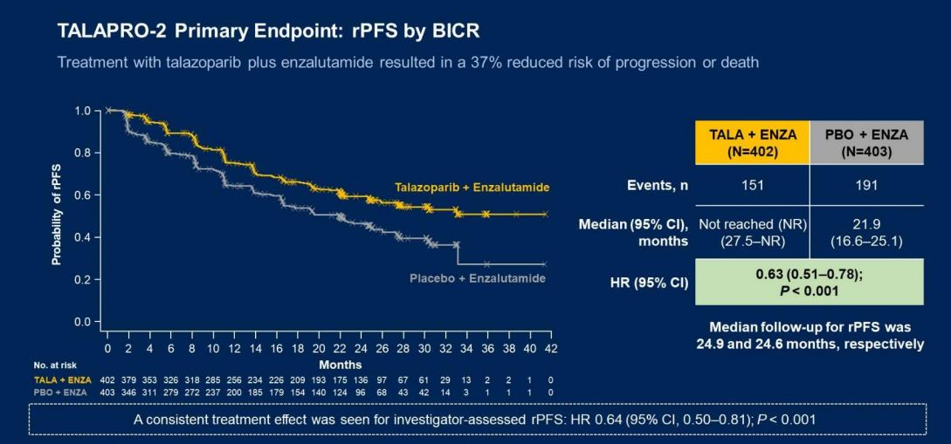
mCRPC: TALAPRO-2 TRIAL
Agarwal N, GUASCO 2023
Content of this presentation is copyright and responsibility of the author. Permission is required for re-use.

Slide 44
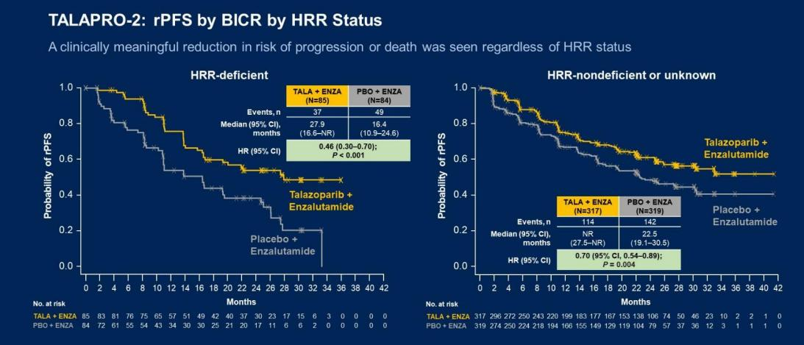
mCRPC: TALAPRO-2 TRIAL
Agarwal N, GUASCO 2023
Content of this presentation is copyright and responsibility of the author. Permission is required for re-use.

Slide 45
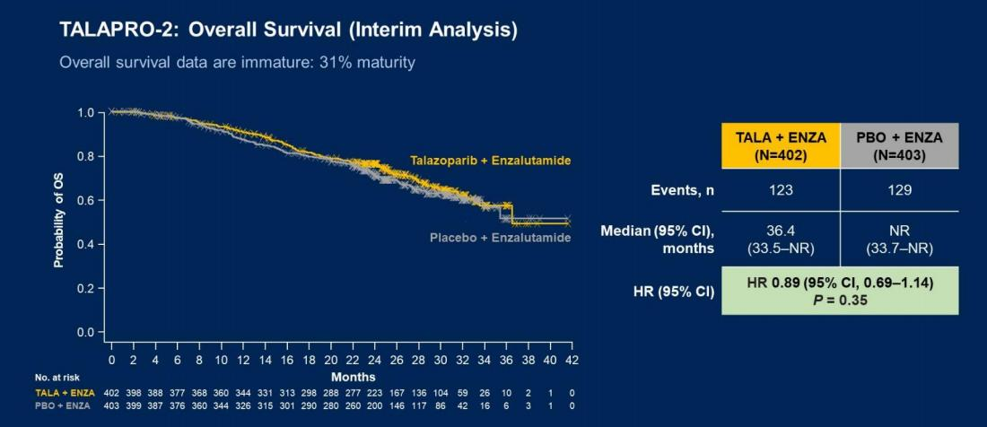
mCRPC: TALAPRO-2 TRIAL
Agarwal N, GUASCO 2023
Content of this presentation is copyright and responsibility of the author. Permission is required for re-use.

Slide 46
mCRPC: sau ADT + ARPI ± DOCETAXEL
mHSPC: ADT plus ARPI ± Docetaxel | Treatment | Primary Endpoints | Approval CH | Reference
 | Olaparib Monotherapy vs ARPI Switch | • BRCA1/2, ATM OS: 19.1mvs 14.7m • BRCA1/2, ATM rPFS: 7.4 vs 3.6m | mCRPC, only BRCA1/2, after 1 ARPI | PROfound De Bono NEJM 2019
 | Rucaparib Mono tx vs ARPI or Docetaxel | • BRCA1/2 OS: not significant • BRCA1/2 rPFS: 11.2 vs 6.4m | CH no approval FDA: mCRPC only BRCA1/2 after 1 ARPI | TRITON3 Fizazi NEJM 2023
 | Docetaxel vs Mitoxantron | • OS: 18.9 vs 16.5m • rPFS: not available | mCRPC first-line* | TAX327 Tannock NEJM 2004
 | Cabazitaxel vs. Mitoxantron | • OS: 15.1 vs 12.7m • rPFS: not available | mCRPC after Docetaxel (PDonor after <6 months of Docetaxel) | TROPIC De Bono Lancet 2010
 | ¹⁷⁷ Lu-PSMA vs ARPI Switch | • OS: not significant yet • rPFS 12.02 vs 5.59m | Pending | PSMAfore Sartor ESMO 2023
 | ¹⁷⁷ Lu-PSMA vs ARPI Switch | • OS 15.3 vs. 11.3m • rPFS 8.7 vs. 3.4m | mCRPC after ARPI and Docetaxel | VISION Sartor NEJM 2021
 | Radium-223 vs Best standard of care | • OS 14.9 vs 11.3m • rPFS: NA | mCRPC after 2 lines (or not eligible) and no visceral metastases | ALSYMPCA Parker NEJM 2013
Aurelius Omlin
* Docetaxel Re-Challenge: limited antitumour activity
Content of this presentation is copyright and responsibility of the author. Permission is required for re-use.

Slide 47
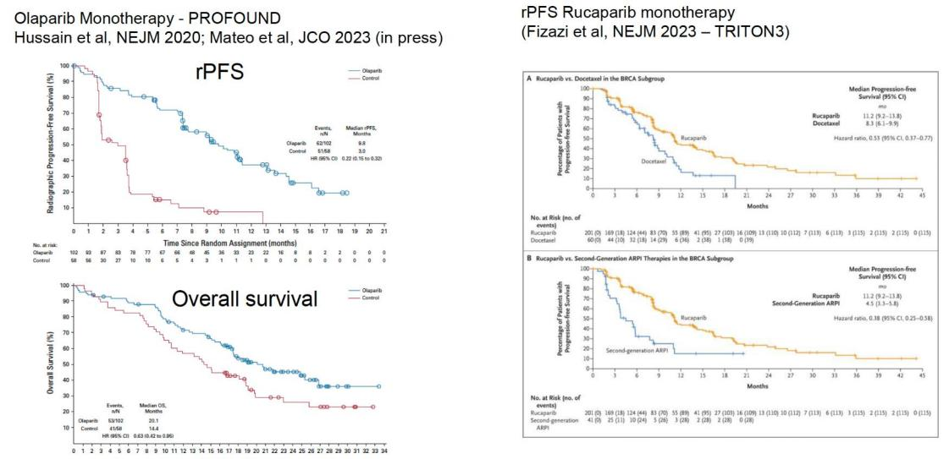
PARPI đơn trị
_{Matteo} _{J.} _{ESMO} ₂₀₂₃ Content of this presentation is copyright and responsibility of the author. Permission is required for re-use.

Slide 48



Điều trị mCRPC: Chỉ có ADT trước đó
Prior Therapy
1st line mCRPC
2nd line mCRPC
3rd line mCRPC***
- Abiraterone - Enzalutamide - ARPI + PARPi (??)
- Docetaxel - Radium-223*
- ¹⁷⁷ Lu-PSMA** - Cabazitaxel - Radium-223*
Non-HRR Mut
ADT alone
Abiraterone + Olaparib Abiraterone + Niraparib Enzalutamide + Talazoparib
- Docetaxel - Radium-223*
- ¹⁷⁷ Lu-PSMA** - Cabazitaxel (+- plartinum) - Radium-223*
HRR Mut
(esp BRCA)
*Only for patients with bone predominant disease
** Only for patients eligible based on PSMA/PET imaging
*** In case of MSI-H orTMB > 10, consider immunotherapy
Obs: always consider bone protecting agents (ZA or Denosumab)
Content of this presentation is copyright and responsibility of the author. Permission is required for re-use.

Slide 49
Điều trị mCRPC: Chỉ có ADT trước đó
Prior Therapy
1st line mCRPC
2nd line mCRPC
3rd line mCRPC***
- Abiraterone - Enzalutamide - ARPI + PARPi (??)
- Docetaxel - Radium-223*
- ¹⁷⁷ Lu-PSMA** - Cabazitaxel - Radium-223*
Non-HRR Mut
ADT alone
Abiraterone + Olaparib Abiraterone + Niraparib Enzalutamide + Talazoparib
- Docetaxel - Radium-223*
- ¹⁷⁷ Lu-PSMA** - Cabazitaxel (+- plartinum) - Radium-223*
HRR Mut
(esp BRCA)
*Only for patients with bone predominant disease
** Only for patients eligible based on PSMA/PET imaging
*** In case of MSI-H orTMB > 10, consider immunotherapy
Obs: always consider bone protecting agents (ZA or Denosumab)
Content of this presentation is copyright and responsibility of the author. Permission is required for re-use.

Slide 50
Điều trị mCRPC: ADT + ARPI
Prior Therapy
1st line mCRPC
2nd line mCRPC
3rd line mCRPC***
- Docetaxel - Radium-223*
- ¹⁷⁷ Lu-PSMA** - Cabazitaxel - Radium-223*
Option not used in prior lines of therapy
Non-HRR Mut
ADT + ARPI
- Olaparib - Rucaparib - ARPI + PARPi (??)
- Docetaxel - Radium-223*
- ¹⁷⁷ Lu-PSMA** - Cabazitaxel (+- plartinum) - Radium-223*
HRR Mut
(esp BRCA)
*Only for patients with bone predominant disease
** Only for patients eligible based on PSMA/PET imaging
*** In case of MSI-H orTMB > 10, consider immunotherapy
Obs: always consider bone protecting agents (ZA or Denosumab)
Content of this presentation is copyright and responsibility of the author. Permission is required for re-use.

Slide 51
Điều trị mCRPC: ADT + ARPI
Prior Therapy
1st line mCRPC
2nd line mCRPC
3rd line mCRPC***
- Docetaxel - Radium-223*
- ¹⁷⁷ Lu-PSMA** - Cabazitaxel - Radium-223*
Option not used in prior lines of therapy
Non-HRR Mut
ADT + ARPI
- Olaparib - Rucaparib - ARPI + PARPi (??)
- Docetaxel - Radium-223*
- ¹⁷⁷ Lu-PSMA** - Cabazitaxel (+- plartinum) - Radium-223*
HRR Mut
(esp BRCA)
*Only for patients with bone predominant disease
** Only for patients eligible based on PSMA/PET imaging
*** In case of MSI-H orTMB > 10, consider immunotherapy
Obs: always consider bone protecting agents (ZA or Denosumab)
Content of this presentation is copyright and responsibility of the author. Permission is required for re-use.

Slide 52

Y học thực chứng: cá thể hóa điều trị UTTTL

Slide 53
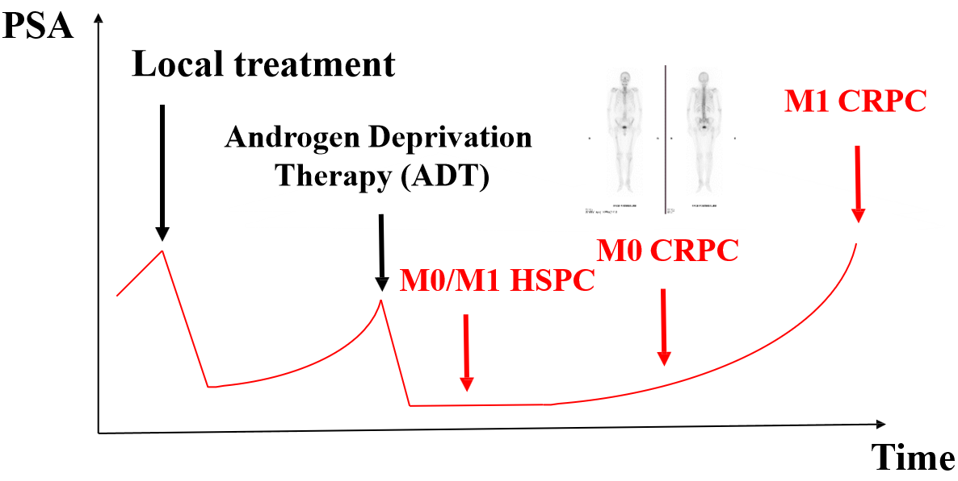
Diễn tiến sinh học ung thư tuyến tiền liệt

Slide 54

Cám ơn
PSA PFS , OS & QoL

Slide 55
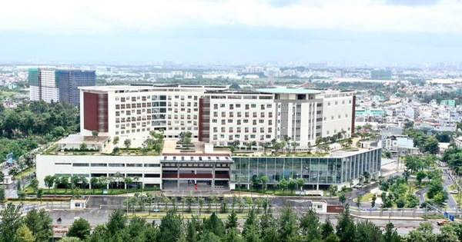
Cảm ơn

